Slide 1
INTRODUCTION
A STRAIGHT LINE IS THE SHORTEST DISTANCE BETWEEN TWO POINTS.
PROJECTIONS OF THE ENDS OF ANY LINE CAN BE DRAWN USING THE PRINCIPLES FOR THE PROJECTIONS OF POINTS.

Slide 2
````INTRODUCTION
TOP VIEWS OF THE TWO END POINTS OF A LINE, WHEN JOINED GIVE THE TOP VIEW OF THE LINE.
FRONT VIEWS OF THE TWO END POINTS OF THE LINE ,WHEN JOINED ,GIVE THE FRONT VIEW OF THE LINE. BOTH THESE PROJECTIONS ARE STRAIGHT LINES.

Slide 3
PROJECTIONS OF STRAIGHT LINES
POSSIBLE POSITIONS
With Respect to H.P.
Parallel to the H.P.
Perpendicular to the H.P.
Inclined to the H.P.
With Respect to V.P.
Parallel to the V.P.
Perpendicular to the V.P.
Inclined to the V.P.

Slide 4
Parallel to the H.P.

Slide 5
Perpendicular to the H.P.

Slide 6
Inclined to the H.P.

Slide 7
Parallel to the V.P.

Slide 8
Perpendicular to the V.P.

Slide 9
Inclined to the V.P.

Slide 10
Parallel to Both Planes

Slide 11
Perpendicular to One Plane (parallel to the other plane)
Perpendicular to H.P. (must be parallel to the V.P.)

Slide 12
Perpendicular to V.P. (must be parallel to the H.P.)

Slide 13
Inclined to One Plane and parallel to the other plane
Inclined to the H.P. and parallel to the V.P.

Slide 14
Inclined to One Plane and parallel to the other plane
Inclined to the V.P. and parallel to the H.P.

Slide 15
Inclined to Both Planes

Slide 16
POSITIONS OF A STRAIGHT LINE WITH RESPECT TO THE TWO PLANES
Parallel to both planes
Perpendicular to one plane (must be parallel to the other plane)
Perpendicular to the H.P. (must be parallel to the V.P.)
Perpendicular to the V.P. (must be parallel to the H.P.)
Inclined to one plane and parallel to the other plane
Inclined to the H.P. and parallel to the V.P.
Inclined to the V.P. and parallel to the H.P.
Inclined to both planes

Slide 17
PROJECTION RULE OF PARALLELISM
If a straight line is parallel to a principal plane, its projection on the same principal plane must be equal to its True Length (T.L.), whereas its projection on the other principal plane must be parallel to the xy line.
Line is parallel to the H.P., therefore its T.V. is T.L. and F.V. parallel to xy.
Line is parallel to the V.P., therefore its F.V. is T.L. and T.V. parallel to xy.

Slide 18
Line is parallel to the H.P., therefore its T.V. is T.L. and F.V. parallel to xy.

Slide 19
Line is parallel to the H.P., therefore its T.V. is T.L. and F.V. parallel to xy.

Slide 20
Line is parallel to the V.P., therefore its F.V. is T.L. and T.V. parallel to xy.

Slide 21
Line is parallel to the V.P., therefore its F.V. is T.L. and T.V. parallel to xy.

Slide 22
If the F.V. is T.L., then the T.V. is parallel to xy line.
If the T.V. is T.L., then the F.V. is parallel to xy line.
If the T.V. is parallel to xy line, then the F.V. is T.L.
If the F.V. is parallel to xy line, then the T.V. is T.L.
If one view is T.L., the other must be parallel to xy.
If one view is parallel to xy, the other must be T.L.

Slide 23
Engineering Graphics Lecture Notes
SUMMARY OF PROJECTION OF LINES
S.NO | POSITION OF LINE | FRONT VIEW | TOP VIEW
1 | LINE PARALLEL TO BOTH V.P & H.P | HORIZONTAL LINE PARALLEL TO XY | HORIZONTAL LINE PARALLEL TO XY
2 | LINE PERPENDICULAR TO H.P AND PARALLEL TO V.P | VERTICAL LINE | POINT
3 | LINE PERPENDICULAR TO V.P AND PARALLEL TO H.P | POINT | VERTICAL LINE
4 | LINE PARALLEL TO H.P AND INCLINED TO V.P AT ANGLE “Ѳ” | LINE PARALLEL TO XY WITH FORESHORTENED LENGTH | INCLINED LINE WITH TRUE LENGTH
5 | LINE PARALLEL TO V.P AND INCLINED TO H.P AT ANGLE“Ѳ” | INCLINED LINE WITH TRUE LENGTH | LINE PARALLEL TO XY WITH FORESHORTENED LENGTH

Slide 24
Straight line AB 60mm
End A is 40 mm above the H.P. and 50 mm in front of the V.P.
Line is parallel to the V.P. and inclined 30 degree to the H.P., therefore F.V. (a’b’) is T.L.
End B is also above the H.P. and in front of the V.P.

Slide 27
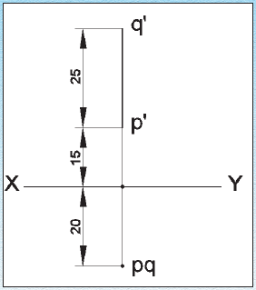
Engineering Graphics Lecture Notes
EXAMPLE PROBLEMS:-
I.DRAW THE PROJECTION OF A LINE PQ, 25 mm LONG IN THE FOLLOWING POSITIONS
Perpendicular to the H.P., 20 mm infront of V.P and its one end 15 mm above the H.P

Slide 28
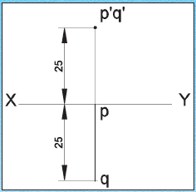
Engineering Graphics Lecture Notes
EXAMPLE PROBLEMS:-
ii.DRAW THE PROJECTION OF A LINE PQ, 25 mm LONG IN THE FOLLOWING POSITIONS
Perpendicular to the V.P., 25 mm above the H.P and its end in the V.P

Slide 29
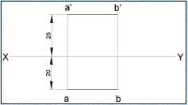
Engineering Graphics Lecture Notes
EXAMPLE PROBLEMS:-
iii.Draw the projection of a 30 mm long AB, straight line parallel to both H.P and V.P and 25 mm above H.P and 20 mm infront of V.P

Slide 30
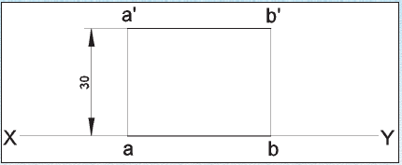
Engineering Graphics Lecture Notes
EXAMPLE PROBLEMS:-
IV.Draw the projection of a 30 mm long AB, straight line parallel to and 30 mm above H.P and in the V.P

Slide 31
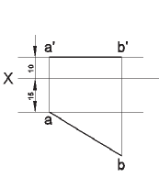
Engineering Graphics Lecture Notes
EXAMPLE PROBLEMS:-
V.Draw the projection of a straight line AB of 40 mm length is parallel to the H.P and inclined at 30° to the V.P. its end point A is 10 mm from the H.P and 15 mm from the V.P

Slide 32
THANK YOU

